Slide 1
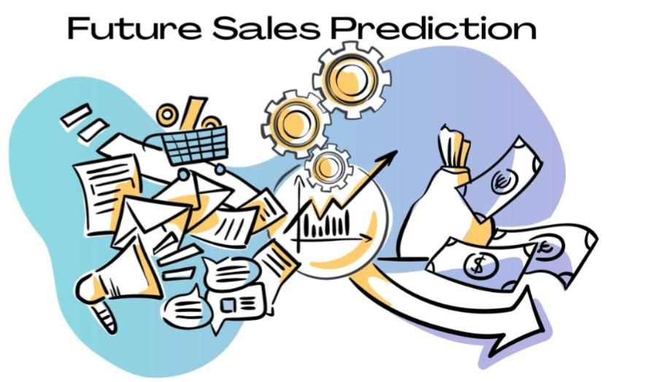

Slide 2
INTRODUCTION
A sales forecast is an in-depth report that predicts what a salesperson, team, or company will sell weekly, monthly, quarterly, or annually.
Sales forecasts are typically created using past performance data. Managers use reps’ sales forecasts to estimate the business their team will close. A sales forecast is a data-driven expression of expected sales revenue from our product or service.
forcasting is strictly concerned with future events only.

Slide 3
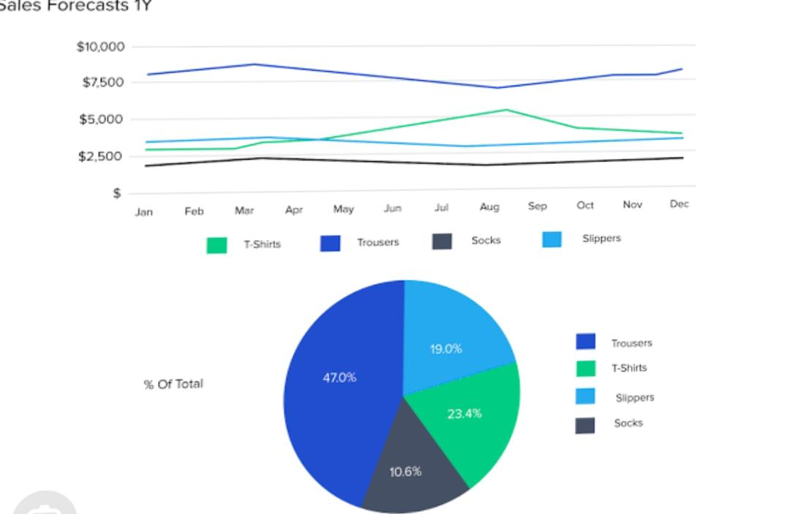
Sales prediction analysis

Slide 4
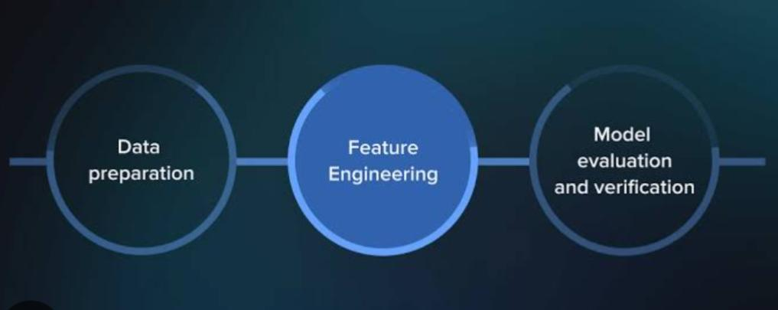
Future of sales prediction
STEPS

Slide 5
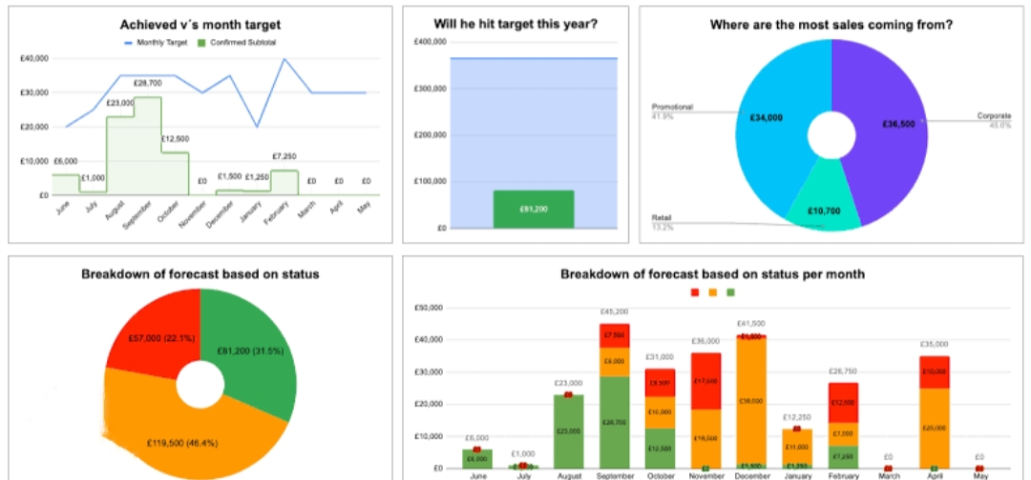

Slide 6
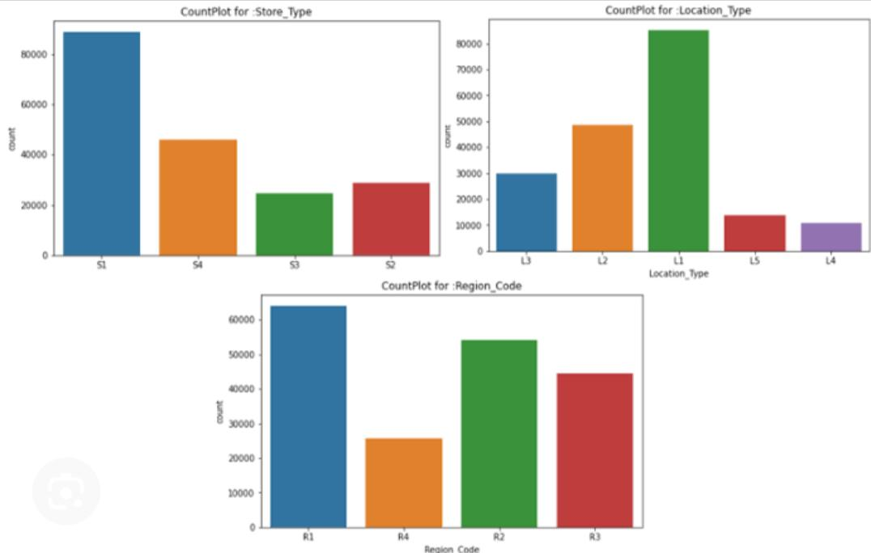
Month vise sales prediction

Slide 7
Future engineering
Sales engineers are an essential part of the tech sales process. They work together with sales representatives to create a cohesive pre-sales consultation process. Their work includes the qualification and closure of deals in the tech sales industry
Overall, sales engineers are incredibly important as they perform technical discovery, evaluation of technological viability, and risk mitigation. They perform this work by creating and executing prototypes and proofs of concept.
Sales engineers are essentially engineers with deep business savvy and exceptional skills at communicating. They know their product and industry, while also knowing how to reach the heart of potential customers and manage sales.

Slide 8
Predictive sales analysis based on previous data is crucial for organizations to make educated decisions and remain competitive.
Machine learning is a powerful technology that can automate this process, producing more accurate and informed forecasts.
Machine learning has revolutionized many sectors, including sales and marketing.
Machine learning algorithms can forecast consumer behaviour and sales trends by analyzing data and discovering patterns, hidden patterns, and linkages.
The purpose of this research is to propose an understanding of the usage of machine learning algorithms for predicting future sales of Big Mart enterprises based on past year sales.
Utilizing machine learning methods like Linear Regression and Gradient Boost, a thorough study of sales forecasting is undertaken.

Slide 9
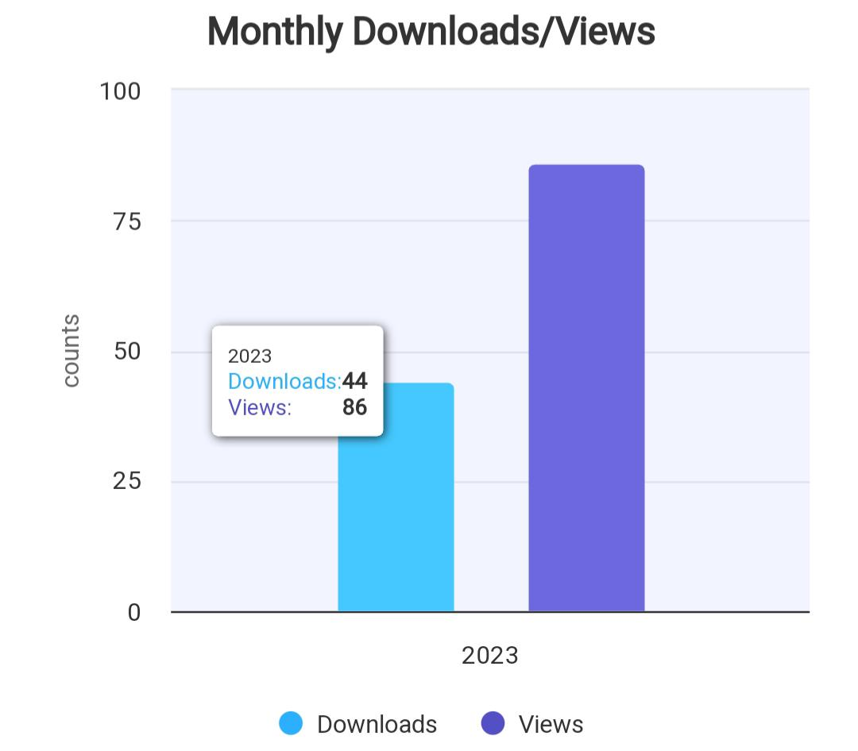
The performance of the Linear Regression and Gradient Boosting methods was evaluated using metrics such as mean absolute error, mean squared error, R2 score, and Accuracy.
The studys findings can help businesses make better informed decisions about resource allocation, production planning, and marketing methods.
Overall, machine learning is a powerful tool for forecasting sales and can assist organizations in staying ahead of the curve in a fast changing industry.

Slide 10
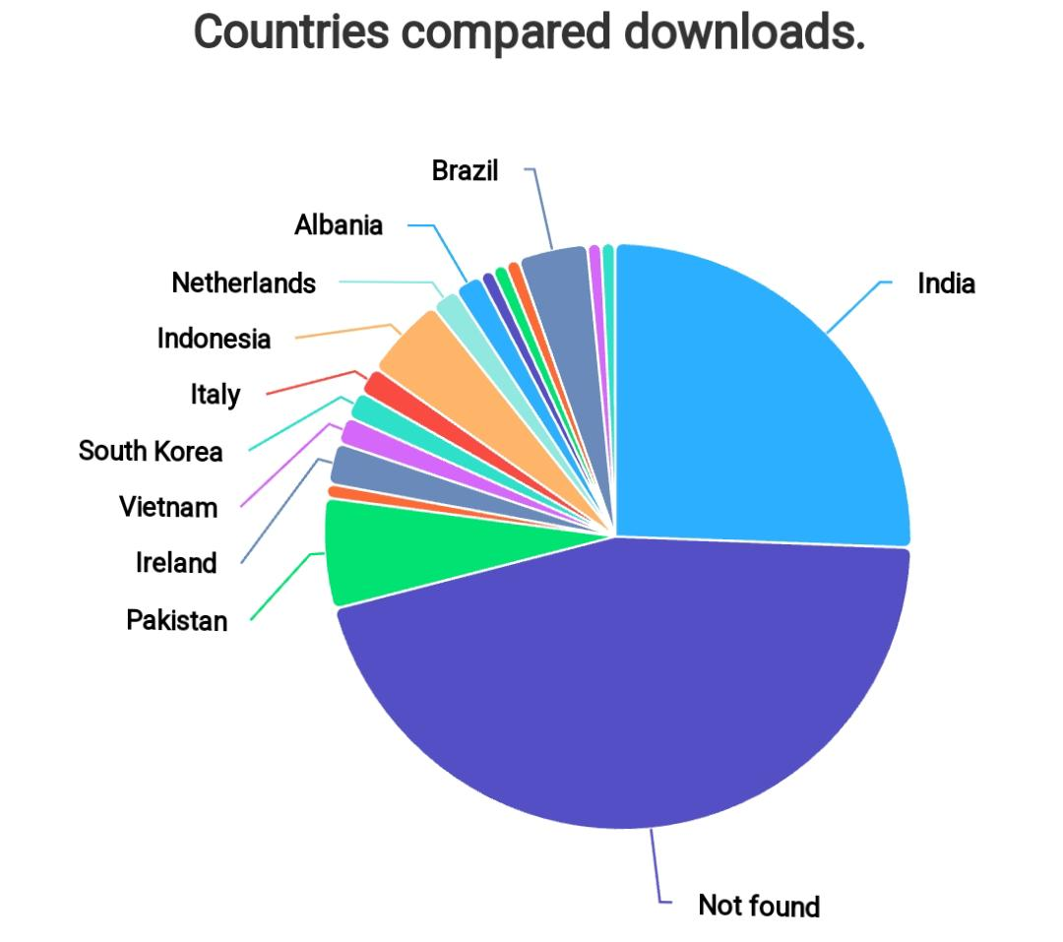

Slide 11
Input data
Catgs[‘type’] = catgs.item_category_name.apply(lambda x: x.split(‘ ‘)[0]).astype(str) catgs.loc[(catgs.type == ‘Игровые’) | (catgs.type == ‘Аксессуары’), ‘category’] = ‘Игры’ catgs.loc[catgs.type == ‘PC’, ‘category’] = ‘Музыка’ category = [‘Игры’, ‘Карты’, ‘Кино’, ‘Книги’,’Музыка’, ‘Подарки’, ‘Программы’, ‘Служебные’, ‘Чистые’, ‘Аксессуары’] catgs[‘type’] = catgs.type.apply(lambda x: x if (x in category) else ‘etc’) print(catgs.groupby([‘type’]).sum()) catgs[‘type_code’] = LabelEncoder().fit_transform(catgs[‘type’]) # if subtype is nan then type catgs[‘split’] = catgs.item_category_name.apply(lambda x: x.split(‘-’)) catgs[‘subtype’] = catgs[‘split’].map(lambda x: x[1].strip() if len(x) > 1 else x[0].strip()) catgs[‘subtype_code’] = LabelEncoder().fit_transform(catgs[‘subtype’]) catgs = catgs[[‘item_category_id’,’type_code’, ‘subtype_code’]] catgs.head()

Slide 12
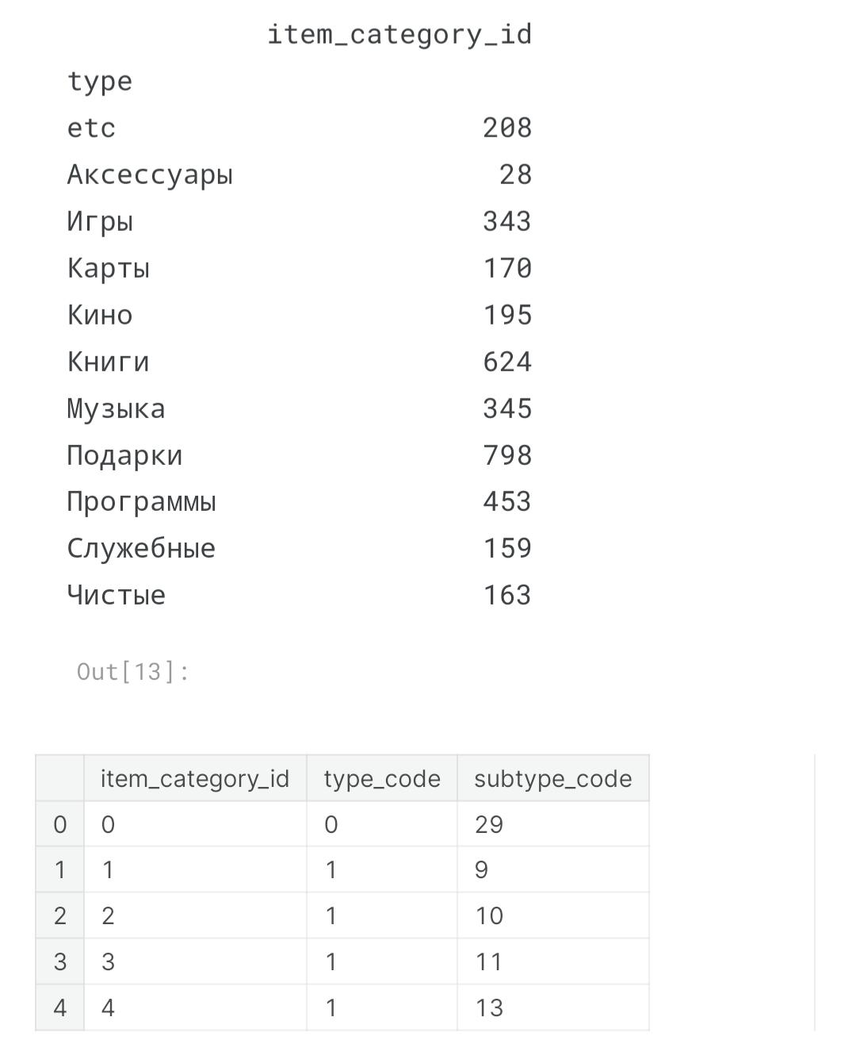

Slide 13
Model training
One of the most common methods used to predict sales is regression analysis.
This method involves using historical sales data to train a model that can predict future sales.
The model can take into account factors such as past sales, marketing campaigns, and economic indicators to make its predictions.
The main models are trend analysis, regression analysis, and causal analysis.
These are different methods that you should review for their fit with your specific circumstances.
Each method has its own strengths and weaknesses, so it’s important to choose the right one based on your specific needs.

Slide 14
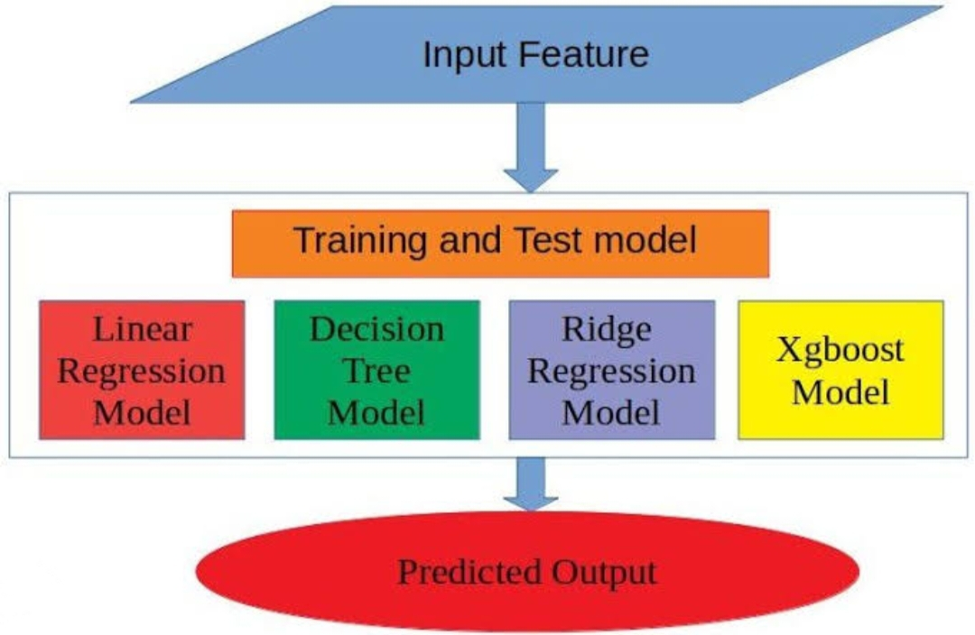

Slide 15
1. Time and series forecast Time series forecasting models are used to project future sales based on past sales trends. These models take into account the seasonality of a product or service to better predict future demand.
2. Regression forecasting model Regression forecasting models use historical data and linear regression techniques to predict upcoming sales. This method looks at many different factors over time including: market conditions, customer sentiment, economic trends, consumer behavior, competition, and more.
3. Historical forecasting model Historical forecasting uses historical data to make predictions about future sales. It is widely used in retail businesses, as well as within other industries such as banking and insurance
4. Opportunity stage sales forecasting model Opportunity stage sales forecasting models use current customer pipelines and open opportunities to predict upcoming demand. These models look at factors like customer sentiment, product popularity, current buying trends, and more to provide a better understanding of what customers may be purchasing soon.

Slide 16
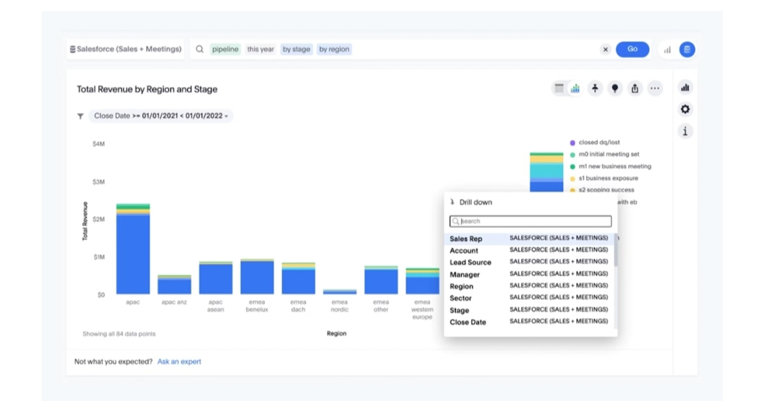
5. Lead value sales forecasting model Lead value sales forecasting models use data from customer leads to predict future demand. The data can be pulled from a variety of factors such as contact information, past purchases, interests, demographics, and more. Once analyzed with the lead value sales forecasting model, this data provides an accurate estimate of which leads may be likely to convert into customers in the future
6. Length of sales cycle forecasting model In length of sales cycle forecasting models, data from previous customers’ purchasing behavior is used to forecast the time it will take for potential customers to purchase a product or service. This model looks at customer segmentation, customer lifetime value, product popularity, geographic region, and other factors to estimate the average time it will take for customers to make a purchase.
7. Intuitive sales forecasting model Intuitive sales forecasting is a method for predicting future performance using intuition, experience, and judgment. Therefore, it is a more qualitative approach to forecasting. This model is often used in businesses where forecasting based on historical data may not be as reliable due to the nature of the industry or products. Intuitive sales forecasting can also be useful for making decisions about marketing spend, strategies investments, and improving

Slide 17
Evaluation
The first step to evaluate your sales forecast and plYou can use metrics such as forecast error, forecast bias, and forecast attainment to compare your forecast with your actual results.
Forecast error is the difference between your forecast and your actual sales, expressed as a percentage.an is to review the assumptions that underlie them.
These include factors such as market size, demand, competition, pricing, seasonality, and conversion rates.
Forecast accuracy is the measure of how accurately a given forecast matches actual sales. Forecast bias describes how much the forecast is consistently over or under the actual sales.
Common metrics used to evaluate forecast accuracy include Mean Absolute Percentage Error (MAPE) and Mean Absolute Deviation (MAD).

Slide 18
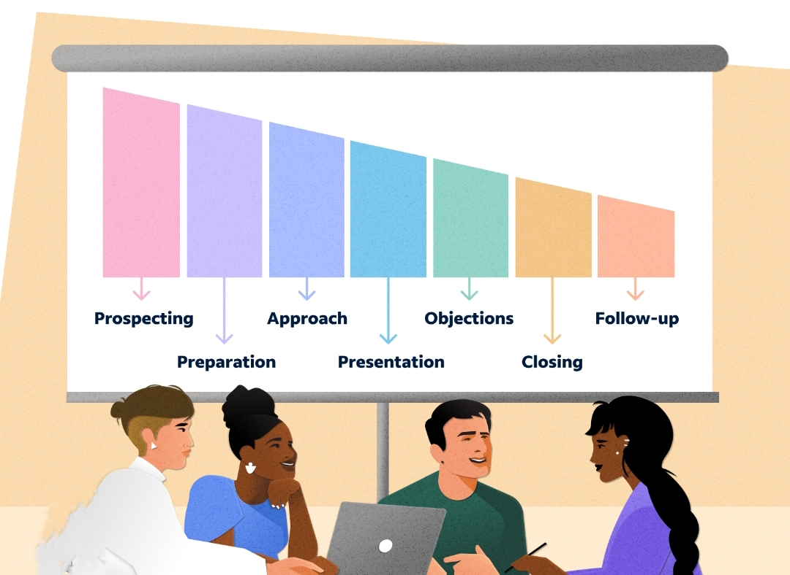

Slide 19
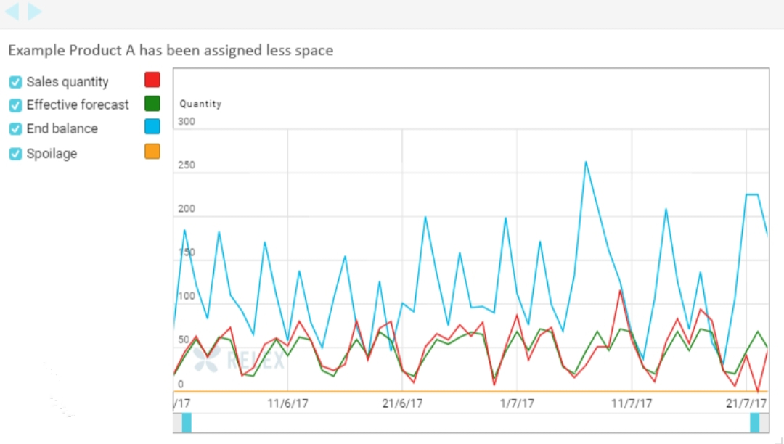

Slide 20


